Slide 1
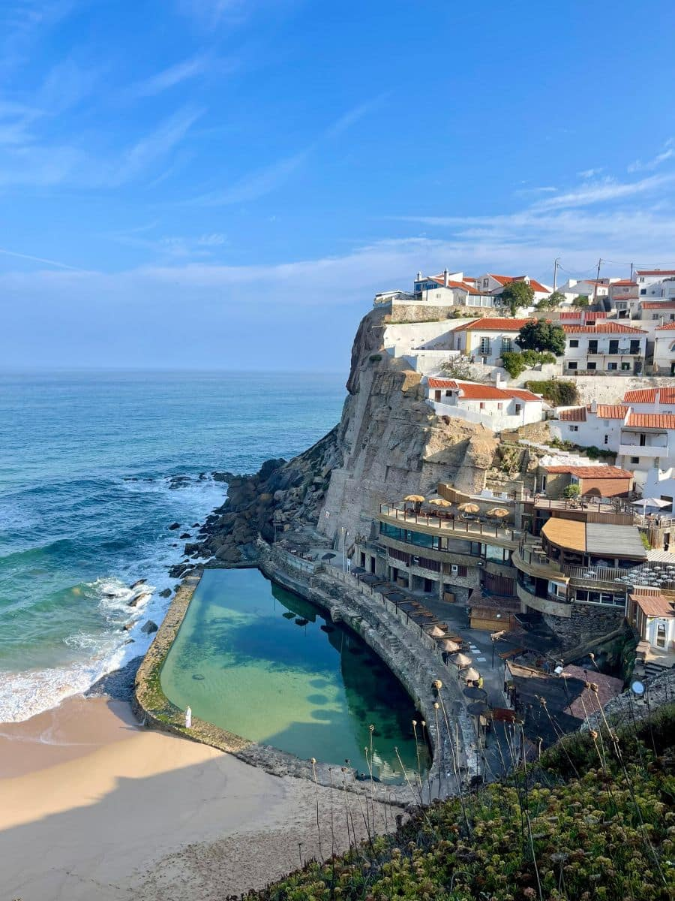
Global Fintech: Italy, Spain, and Portugal
Mckenna Davies, Tiernan Geary, Nick Parrish, Asad Yussuf, and Daylen Bowen

Slide 2
Table of Contents
Italy
Strengths
Weaknesses
Threats
Opportunities
Star Fintechs
Spain
Strengths
Weaknesses
Threats
Opportunities
Star Fintechs
Portugal
Strengths
Weaknesses
Threats
Opportunities
Star Fintechs
Works Cited

Slide 3

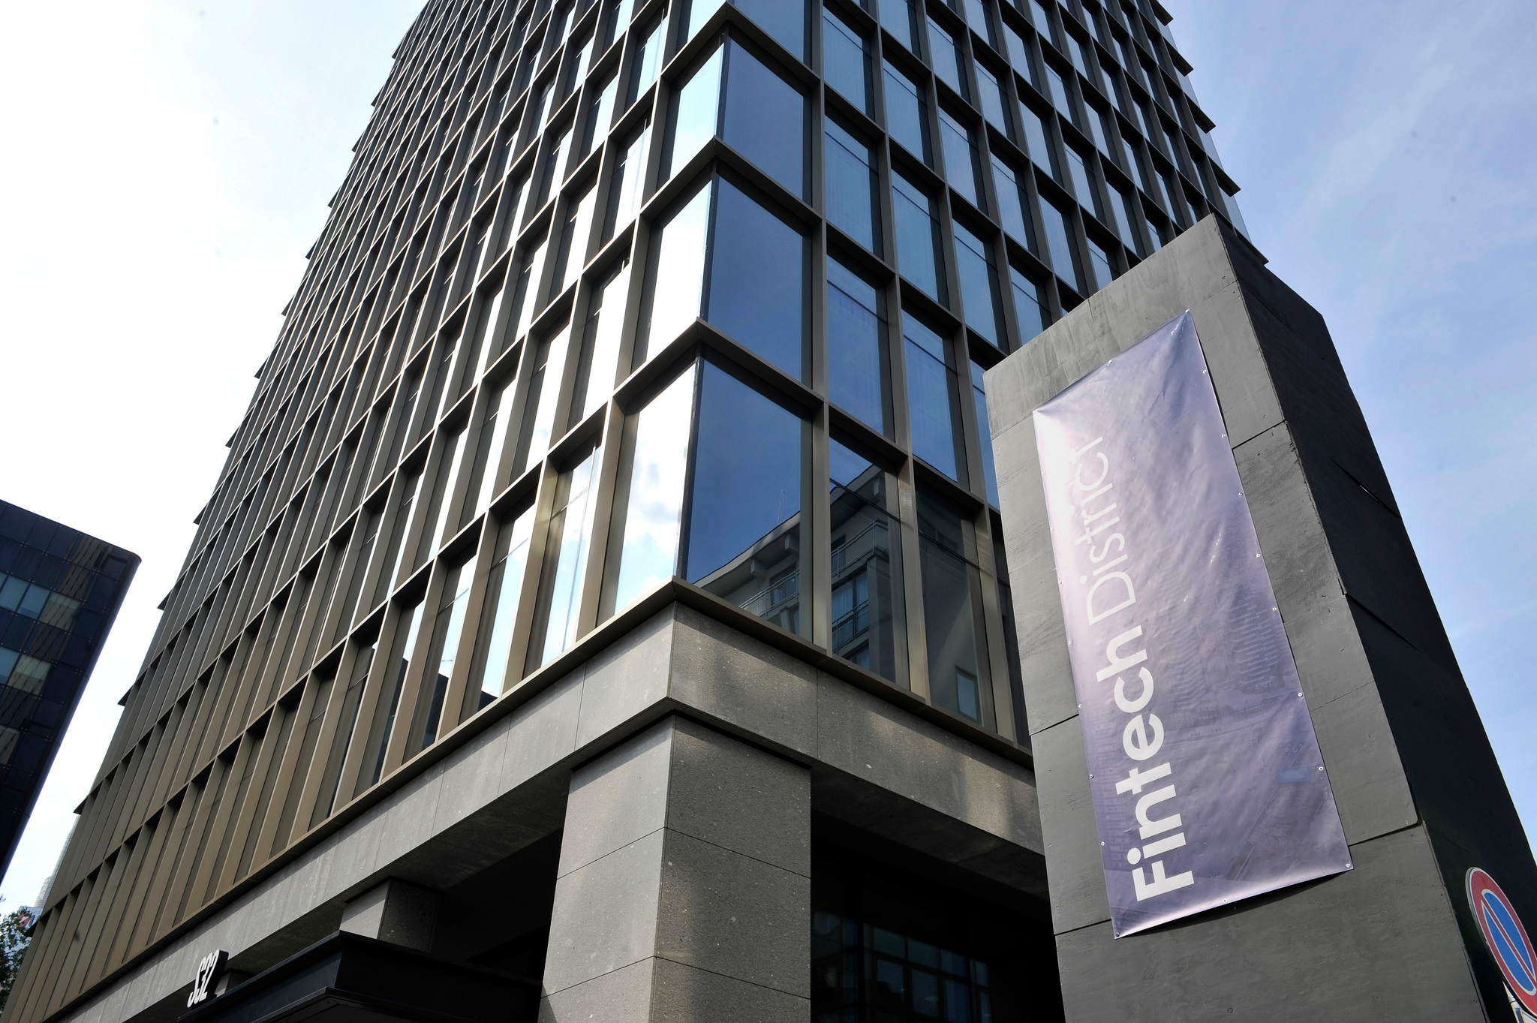
Italy – Strengths
Current Landscape
Over 600 fintechs
Key areas in payments, lending, wealthtech, and cryptocurrency
Expanding Ecosystem
Fintech District (Est. 2017, Milan)
Fintech community of 300+ fintech companies (Revolut, Klarna, and N26)
Raised over €80 million in 2024
Strong Talent Pool
Over 21,000 annual graduates in microelectronics-related disciplines
Second among European countries for the number of master's degree graduates in engineering and related fields
Public-Private Collaboration
Established Fintech Committee
Fintech Sandbox
Tiernan Geary
Notes:
Tiernan Geary

Slide 4
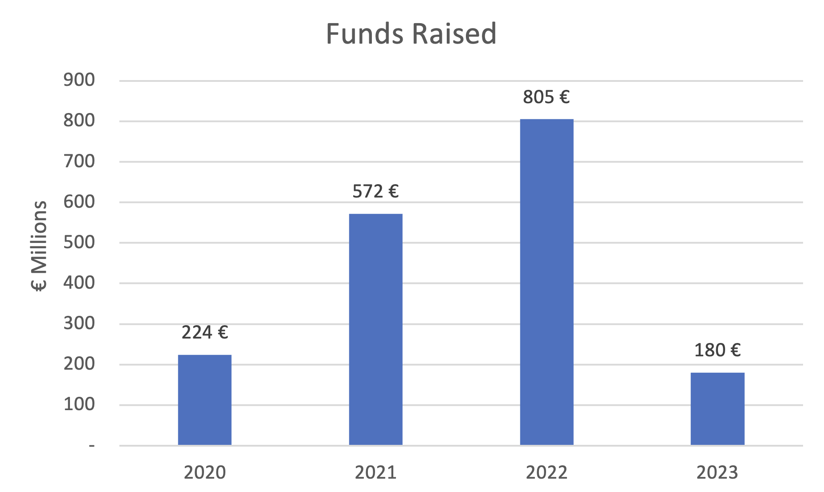
Italy – Weaknesses
Fragmented Regulatory Environment
Multiple authorities with different regulations and processes
Funding Fluctuations (VC)
In 2023, Italian fintech startups raised €180 million, reflecting an 78% decline from the previous year
Dominance of Traditional Banks
Consumers reliant on traditional banks
Slow rate of digital transformation and limited fintech collaboration opportunities
Tiernan Geary
Notes:
Tiernan Geary

Slide 5
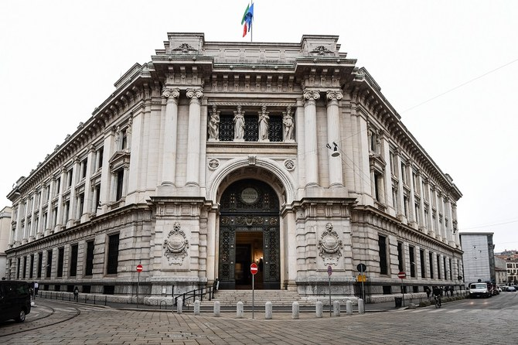
Italy – Threats
Regulatory Crackdowns
In 2024, the Bank of Italy increased restrictions on foreign fintechs operating in Italy without full local licenses
Foreign partners are more likely to avoid the Italian market, limiting collaboration and capital
Global Competition from More Efficient Fintech Hubs
Countries like the UK, Germany, Lithuania, and the Netherlands offer more advanced fintech ecosystems, regulatory sandboxes, and access to funding
The Italian talent pool often leave Italy to seek better opportunities abroad
Tiernan Geary

Slide 6
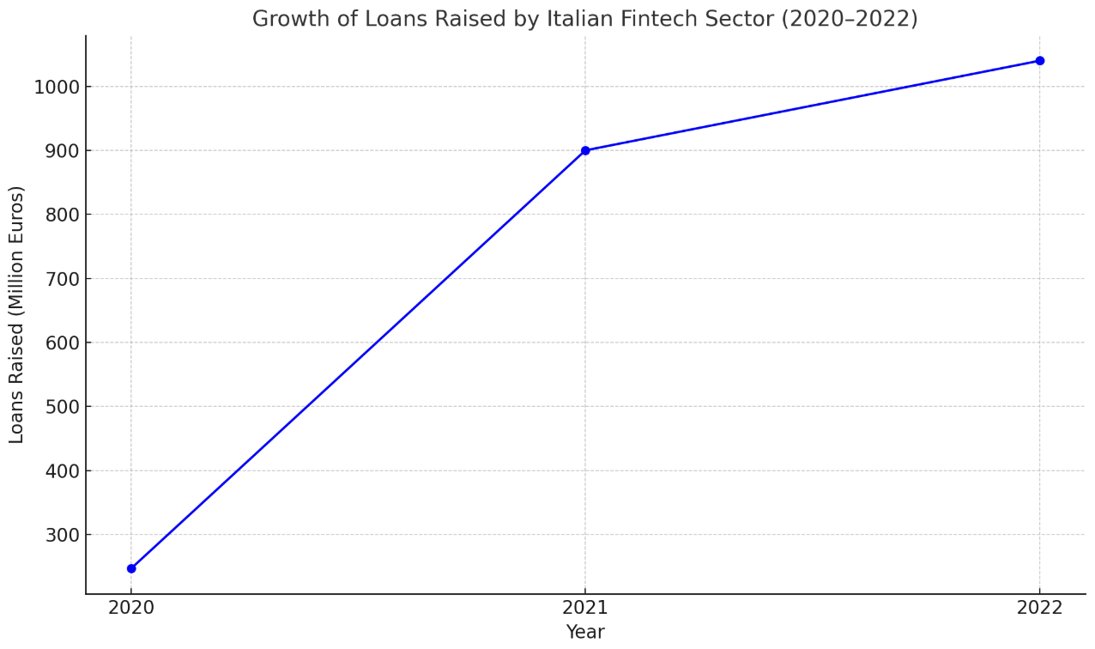
Italy – Opportunities
Increasing Market Growth of Fintech in Italy
Fintech market projected CAGR of 23.7% from 2024 to 2032
Projected market value of US $2.02 Trillion in 2032
Fundraising poised for future growth
In 2023, $1.2 Billion was invested in Italian fintech market
Fintech digital asset market anticipated to constitute 31% of the fintech market in Italy by 2032
Government support for future growth
Government launch of The National Recovery and Resilience Plan (NRRP) allocates €40 billion for digital transformation
https://www.datacuberesearch.com/italy-fintech-digital-payment-market
Daylen Bowen

Slide 7


Italy – Star Fintechs
Postepay (Founded 2003)
Fintech service provided by national postal service Poste Italiane
Payment solution that integrates easily within larger financial service ecosystem
Unique Aspects
Pre-paid cards, not linked to a bank account but loaded with funds
No bank account needed increasing financial inclusion
Integrates with the national postal service infrastructure
Criptalia (Founded 2018)
Lending platform connecting investors with businesses needing financing
Crowdfunding options as well as peer-to peer-financing
Unique Aspects
Criptalia focuses on funding to SMEs in Italy rather than large corporations
Loans are tokenized and blockchain is used ensuring transparency and security for transactions
Investors are able to invest smaller sums in several companies
https://criptalia.com/
https://postepay.poste.it/
Daylen Bowen

Slide 8

Spain – Strengths
Thriving Startup Culture
Spain ranks sixth among European countries with 1420 active fintech companies.
Madrid, Valencia, and Barcelona (80% of fintech located)
High Tech use and fintech adoption
40% of Spanish adults use online banking
Spain Startup Law, Enacted Jan. 1, 2023
Requires one euro of capital to create legal entity
Increases personal income tax deduction for investment in startups from 30% to 50%
Fintech adoption rate of 56% by consumers
21st globally, 7th in Europe
https://fintech.global/2022/11/08/why-spain-could-be-the-next-fintech-powerhouse/
Daylen Bowen

Slide 9
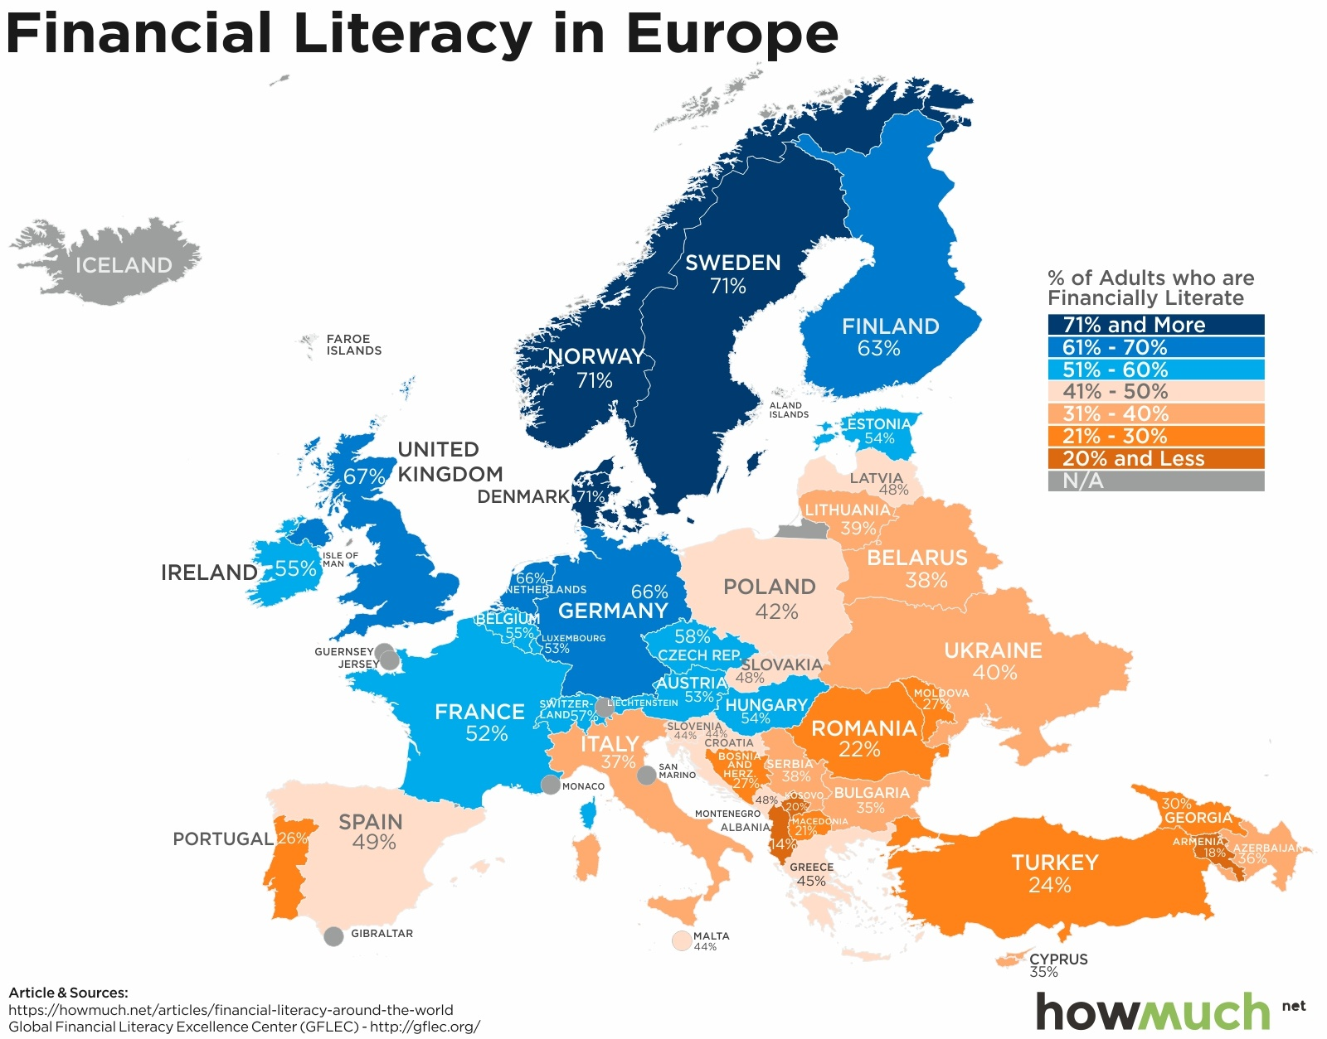
Spain – Weaknesses
Low public awareness and financial literacy limit:
Limits user adoption forces them to traditional banking
Complex regulatory and bureaucratic hurdles:
Difficult for startups to launch slowing innovation
Limited access to funding:
For early stage companies
Shortage of skilled professionals:
Not enough technical knowledge or soft skills
Resistance to digital transformation:
Comfort with traditional banks
Lack of trust and poor user experience:
Leads to low retention and failure
Mckenna Davies

Slide 10

Spain – Threats
Competition from Traditional Banks
EX: Santander and BBVA
Regulatory Environment
Improvement in CNMV lead to complex EU rules
Market Consolidation
Reduce consumer choice
Technological Challenges
Poses threats to smaller firms
Global Economic Conditions
EX: Inflation, Reduced VC funding
(The National Securities Market Commission)
Mckenna Davies

Slide 11
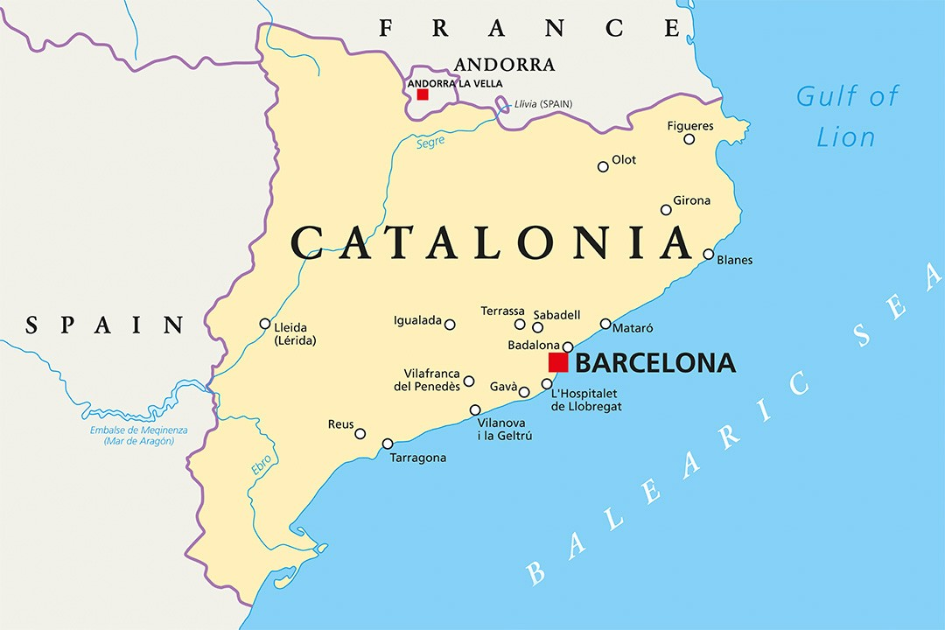
Spain – Opportunities
Market Growth and Emerging Technologies:
Projected growth € 995 billion by 2032
Investment in FinTech Startups:
2024: € 3.1 Billion in investments
Regional Tech Hubs:
Barcelona and Catalonia
Digital Payment Growth:
Increased mobile wallets and payment platforms
Decentralized Finance (DeFi):
More focus on blockchain and cryptocurrencies
Investment Decline and Strategic Shifts:
Ai-driven risk assessment tools, automated investment platforms, innovative lending
Mckenna Davies

Slide 12

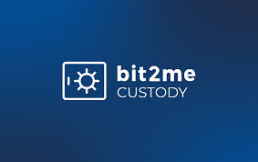
Spain – Star Fintechs
Bnext
Bit2Me
What they do:
Bnext is a fintech company based in Madrid that began as a neobank before developing into a more comprehensive online banking platform.
Why they stand out:
In a single app, they enable users to manage their finances, make payments, and even browse for financial items (such as loans or insurance).
A huge benefit for those who travel or work worldwide is the ability to send money overseas at competitive rates.
Impact:
Bnext is helping shake up traditional banking in Spain. It’s giving users more control, better options, and a much smoother digital experience. It’s especially popular with younger users who expect more from their banks.
What they do:
Bit2Me is the most popular cryptocurrency platform in Spain. It has its own token and allows you can buy, trade, and store a variety of cryptocurrencies.
Why they stand out:
They were among the first cryptocurrency businesses to receive official Bank of Spain recognition.
Additionally, they are the owners of Bit2Me Academy, which has taught millions of individuals the fundamentals of blockchain and cryptocurrency.
Impact:
Bit2Me is a major factor in Spain's rise to prominence in the cryptocurrency market. In addition to providing services, they are educating the public and fostering confidence in this emerging financial sector.
Asad Yussuf

Slide 13

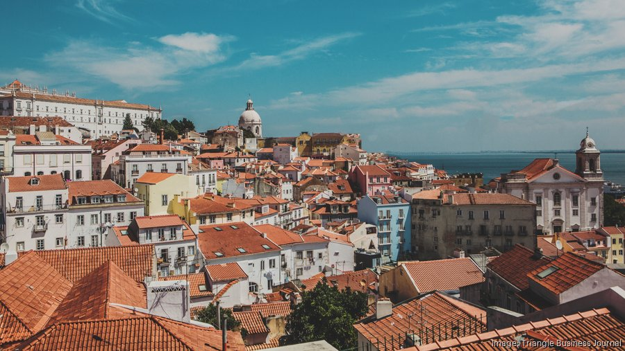
Portugal – Strengths – Fintech Snapshot
The Three: Good, Bad, and Ugly
Strengths: Excellent IT skills, affordable prices, and a welcoming startup environment, particularly in Porto and Lisbon.
Growth Drivers: Include EU financing, digital usage, and a high standard of living that draws in talent from around the world.
Challenges: Include a tiny market size, limited local finance, and difficult cross-border expansion.
Overview of the Ecosystem
Principal Participants: Ebury (FX/payments), Raize (loans), and SIBS (payments).
Support: Portugal Ventures, Fintech House, and Startup Lisboa.
Top Niche: Blockchain, cryptocurrency, lending/crowdfunding, and payments.
The Regulatory Environment
Government Position: Generally encouraging and open to new ideas.
Pros: EU alignment and crypto-friendly regulations help in the growth of companies.
Cons: Administration can slow things down, clarity about regulations is still developing.
Asad Yussuf

Slide 14
Portugal – Weaknesses – Fintech Weaknesses
The Three: Good, Bad, and Ugly
The Good: Openness to digital money, growing startup culture, and proficient in technology talent.
The Bad: Many fintechs depend on foreign investors, social funding is limited.
The Ugly: Scaling is difficult in small local markets, businesses sometimes have to enter foreign markets early, which increases expenses and complexity.
Overview of the Ecosystem
Gaps: Portugal lacks a significant number of high-growth fintechs, despite having several powerful players (such as SIBS and Raize).
Support Restrictions: Although there are incubators and their resources are still being developed in comparison to larger hubs.
Niche Focus: While cryptocurrency and payments are booming, other sectors like wealthtech and insurtech are still underrepresented.
The Regulatory Environment
Challenges: A lack of clarity on newer technology, such as DeFi, and slow-moving bureaucracy.
Crypto Risks: Although the regulations were benevolent, current changes toward taxes and stricter oversight may drive away entrepreneurs.
Conclusion: Although the government is generally fintech-friendly, timeliness and execution are still issues.
Asad Yussuf

Slide 15
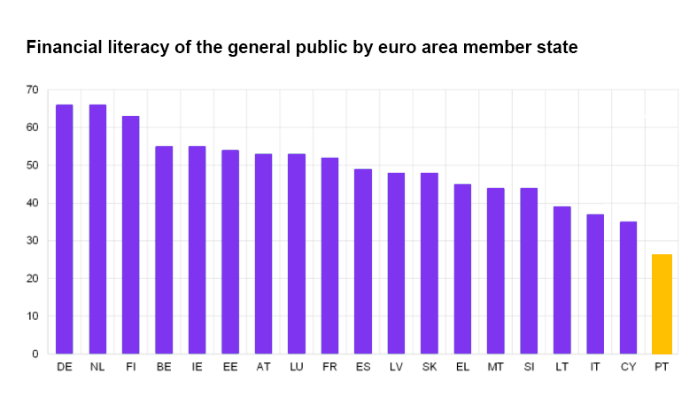
Portugal – Threats
Poor Financial Literacy
Students in Portugal especially rank very low in financial literacy compared to other EU countries
Average financial literacy score of 44.36 out of 100
This can hurt the fintech sector and create a negative perspective of companies
Economic Challenges
Globally, there are issues of high inflation and potential for a recession
Competitive Market
The Fintech market is oversaturated, and investors are more selective
Other EU countries like the UK have more funding and attract more Fintechs
https://www.google.com/url?sa=i&url=https%3A%2F%2Fwww.moneydog.eu%2Fen%2Fblog%2Ffinancial-iliteracy-in-portugal&psig=AOvVaw36PWd0CF5lAhB_GIxSgFr2&ust=1744820933145000&source=images&cd=vfe&opi=89978449&ved=0CBcQjhxqFwoTCJD40dS62owDFQAAAAAdAAAAABAJ
Nick Parrish
Notes:
Portugal’s landscape has strengths and weaknesses, but some possible threats to the fintech market can make entering the industry more difficult.
Poor financial literacy:
(score) this is a drop in score from a previous study which showed an average score of 47.53 out of 100
People will be less inclined to utilize fintech companies, and those who do will make poor investment and payment choices, causing harm that can be blamed on the fintech companies
Economic challenges
Less investments in fintech companies from global economic uncertainty, less willing to take risks

Slide 16
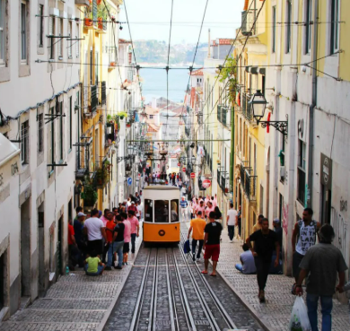
Portugal – Opportunities
Non-restrictive regulatory framework
Portugal’s legislature and regulatory authorities have a more neutral approach to the Fintech industry
Portugal’s regulatory environment is supportive of Fintech growth and innovation
Portugal is a growing Fintech hub
We’ll see more companies base their operations in Portugal to avoid the strict regulatory environments of other countries
Future Projections
Has a CAGR of 16.5%
Reached a cumulative investment of 1.16 billion Euros in 2024
Portugal is backing sectors like blockchain and cryptocurrency, lending and credit, Insurtech, and Regtech
https://www.google.com/url?sa=i&url=https%3A%2F%2Felsacyril.com%2Fthe-beautiful-lisbon-our-3-day-guide%2F&psig=AOvVaw30MUzKWU3n3ZsQSEdp2YrI&ust=1744820712926000&source=images&cd=vfe&opi=89978449&ved=0CBQQjRxqFwoTCMjA4ui52owDFQAAAAAdAAAAABAE
Nick Parrish
Notes:
Portugal is highly technologically advanced and houses great technological infrastructure to facilitate the growth of Fintech companies.

Slide 17


Portugal – Star Fintechs
Coverflex
Digitized compensation management for employers
Unique Aspects:
Some benefits through Coverflex can be tax-exempt
Employees use a Smart card to access different perks
Casafari
Real-estate CRM platform
Consolidates useful information about the real estate market for various investment platforms such as Vanguard, Kronos, Coldwell Banker, Sotheby’s International Realty, etc.
Unique Aspects:
Largest database of information regarding the real estate market
Utilization of AI and Machine Learning to keep their information precise and up-to-date
Nick Parrish
Notes:
There are over 355 fintech companies in Portugal, with that number steadily rising. After listening to us speak about the landscape of the fintech market, let’s explore the standout companies that have achieved immense success through Portugal’s lively fintech market.
Coverflex:
Smart card for employers to manage employee’s compensation, benefits, insurance, discounts, meal allowances, etc.
Casafari:
Its expansive list of information can include insights on market trends, property valuations, potential investment opportunities, etc.
Catered towards real estate professionals like brokers, developers, and investors

Slide 18
Works Cited
Global, Young. “The Evolution of the Italian Fintech Ecosystem.” Ey.com, 2025, www.ey.com/en_it/insights/financial-services/the-evolution-of-the-italian-fintech-ecosystem. Accessed 15 Apr. 2025.
“Italy Pavilion | SEMICON Taiwan.” Semicontaiwan.org, 2025, www.semicontaiwan.org/en/silicon_italy_pavilion. Accessed 15 Apr. 2025.
jjarrett. “Italian FinTech Deal Activity in 2023 on Track to Reach Similar Levels to Previous Year.” FinTech Global, 28 Oct. 2023, fintech.global/2023/10/28/italian-fintech-deal-activity-in-2023-on-track-to-reach-similar-levels-to-previous-year/. Accessed 15 Apr. 2025.
Johnson, Meaghan. “Portugal’s Progressive Policies Fuel Fintech Growth.” Forbes, 13 Dec. 2023, https://www.forbes.com/sites/meaghanjohnson/2023/12/13/portugals-progressive-policies-fuel-fintech-growth/. Accessed 14 Apr. 2025.
“Portugal’s fintech ecosystem attracted over €1 billion in total funding.” EU-Startups, 27 Oct. 2022, https://www.eu-startups.com/2022/10/portugals-fintech-ecosystem-passes-e1-billion-we-take-an-inside-look/. Accessed 15 Apr. 2025.
“Portugal Worse for Financial Literacy.” The Portugal News, 13 Jan. 2022. https://www.theportugalnews.com/news/2022-01-13/portugal-worst-for-financial-literacy/64623. Accessed 15 Apr. 2025.
“Portuguese Fintech Map and Report 2023.” Fintech News CH, 11 Dec. 2023. https://fintechnews.ch/fintechportugal/portuguese-fintech-map-and-report-2023/65442/. Accessed 15 Apr. 2025.
“Spain Fintech Market Size: 2019-2032.” Spain Fintech Market Size | 2019-2032, www.datacuberesearch.com/spain-fintech-market?utm_source=chatgpt.com. Accessed 14 Apr. 2025.
Shibboleth Authentication Request, www-sciencedirect-com.uplib.idm.oclc.org/science/article/pii/S1877959X15001454. Accessed 14 Apr. 2025.
“The Evolution of the Fintech District Ecosystem in 2024.” Fintechdistrict.com, 2024, www.fintechdistrict.com/en/insights/blog/2024-a-year-of-investment-and-collaboration-within-fintech-district-ecosystem/. Accessed 15 Apr. 2025.

